Slide 1
MODULE 2: Cryptography: Key Management, Distribution and User Authentication
-by
Asst Prof Rohini Sawant

Slide 2
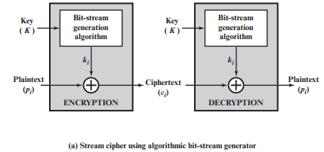
STREAM & BLOCK CIPHERS
A stream cipher is one that encrypts a digital data stream one bit or one byte at a time. Examples of classical stream ciphers are the autokeyed Vigenère cipher and the Vernam cipher.
In the ideal case, a one-time pad version of the Vernam cipher would be used, in which the keystream (ki ) is as long as the plaintext bit stream (pi ).
The bit-stream generator is a key-controlled algorithm and must produce a bit stream that is cryptographically strong.
That is, it must be computationally impractical to predict future portions of the bit stream based on previous portions of the bit stream.
The two users need only share the generating key, and each can produce the keystream.

Slide 3
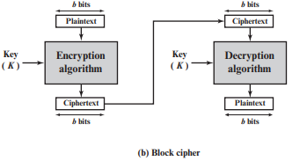
STREAM & BLOCK CIPHERS
A block cipher is one in which a block of plaintext is treated as a whole and used to produce a ciphertext block of equal length.
Typically, a block size of 64 or 128 bits is used.
Far more effort has gone into analyzing block ciphers.
In general, they seem applicable to a broader range of applications than stream ciphers.
The vast majority of network-based symmetric cryptographic applications make use of block ciphers.

Slide 4
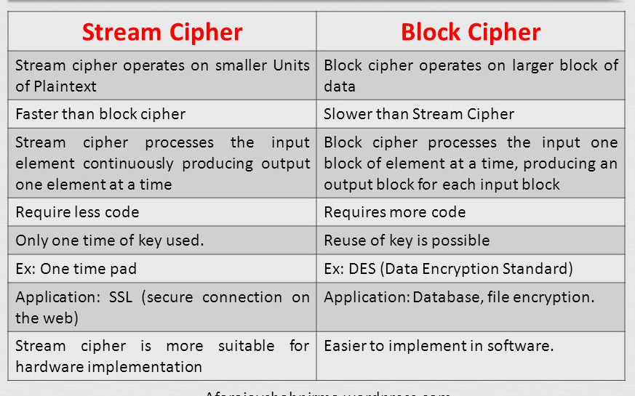

Slide 5
CONFUSION & DIFFUSION
The terms diffusion and confusion were introduced by Claude Shannon to capture the two basic building blocks for any cryptographic system.
Shannon’s concern was to thwart cryptanalysis based on statistical analysis.
In what Shannon refers to as a strongly ideal cipher, all statistics of the ciphertext are independent of the particular key used.
Other than recourse to ideal systems, Shannon suggests two methods for frustrating statistical cryptanalysis: Diffusion and Confusion.
In diffusion, the statistical structure of the plaintext is dissipated into long-range statistics of the ciphertext.
This is achieved by having each plaintext digit affect the value of many ciphertext digits; generally, this is equivalent to having each ciphertext digit be affected by many plaintext digits.
Example of Diffusion is Transposition Cipher.

Slide 6
CONFUSION & DIFFUSION
On the other hand, confusion seeks to make the relationship between the statistics of the ciphertext and the value of the encryption key as complex as possible, again to thwart attempts to discover the key.
Thus, even if the attacker can get some handle on the statistics of the ciphertext, the way in which the key was used to produce that ciphertext is so complex as to make it difficult to deduce the key.
The relations between CT and PT is obscured.
Given a CT, no information about PT, Key, Encryption algorithm is known.
This is achieved by the use of a complex substitution algorithm.

Slide 7
THE FEISTEL CIPHER
Feistel proposed that we can approximate the ideal block cipher by utilizing the concept of a product cipher, which is the execution of two or more simple ciphers in sequence in such a way that the final result or product is cryptographically stronger than any of the component ciphers.
The essence of the approach is to develop a block cipher with a key length of k bits and a block length of n bits, allowing a total of 2^{k} possible transformations, rather than the 2^{n} ! transformations available with the ideal block cipher.
In particular, Feistel proposed the use of a cipher that alternates substitutions and permutations, where these terms are defined as follows:
■ Substitution: Each plaintext element or group of elements is uniquely replaced by a corresponding ciphertext element or group of elements.
■ Permutation: A sequence of plaintext elements is replaced by a permutation of that sequence. That is, no elements are added or deleted or replaced in the sequence, rather the order in which the elements appear in the sequence is changed.

Slide 8
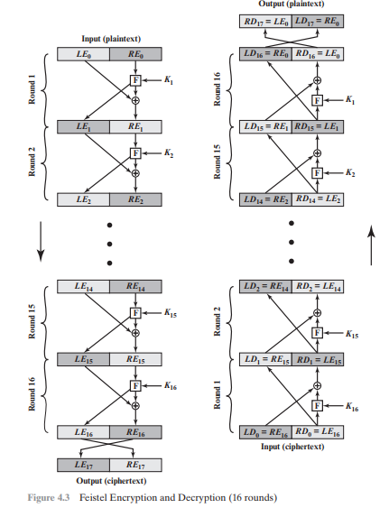

Slide 9
THE FEISTEL CIPHER
The left-hand side of Figure 4.3 depicts the encryption structure proposed by Feistel. The inputs to the encryption algorithm are a plaintext block of length 2w bits and a key K.
The plaintext block is divided into two halves, LE0 and RE0. The two halves of the data pass through n rounds of processing and then combine to produce the ciphertext block.
In general, the subkeys Ki are different from K and from each other.
In Figure 4.3, 16 rounds are used, although any number of rounds could be implemented.

Slide 10
THE FEISTEL CIPHER
All rounds have the same structure. A substitution is performed on the left half of the data. This is done by applying a round function F to the right half of the data and then taking the exclusive-OR of the output of that function and the left half of the data.
The round function has the same general structure for each round but is parameterized by the round subkey Ki .
Following this substitution, a permutation is performed that consists of the interchange of the two halves of the data.
This structure is a particular form of the substitution-permutation network (SPN) proposed by Shannon.

Slide 11
THE FEISTEL STRUCTURE DESIGN FEATURES
Block size: Larger block sizes mean greater security (all other things being equal) but reduced encryption/decryption speed for a given algorithm. Traditionally, a block size of 64 bits has been considered a reasonable tradeoff and was nearly universal in block cipher design. However, the new AES uses a 128-bit block size.
Key size: Larger key size means greater security but may decrease encryption/ decryption speed.
Number of rounds: The essence of the Feistel cipher is that a single round offers inadequate security but that multiple rounds offer increasing security. A typical size is 16 rounds.
Subkey generation algorithm: Greater complexity in this algorithm should lead to greater difficulty of cryptanalysis.

Slide 12
THE FEISTEL STRUCTURE DESIGN FEATURES
Round function F: Again, greater complexity generally means greater resistance to cryptanalysis.
Fast software encryption/decryption: In many cases, encryption is embedded in applications or utility functions in such a way as to preclude a hardware implementation. Accordingly, the speed of execution of the algorithm becomes a concern
Ease of analysis: Although we would like to make our algorithm as difficult as possible to cryptanalyze, there is great benefit in making the algorithm easy to analyze.
The process of decryption with a Feistel cipher is essentially the same as the encryption process. The rule is as follows: Use the ciphertext as input to the algorithm, but use the subkeys Ki in reverse order. That is, use Kn in the first round, Kn-1 in the second round, and so on, until K1 is used in the last round.

Slide 13
DATA ENCRYPTION STANDARD
The Data Encryption Standard (DES) was the most widely used encryption scheme. DES was issued in 1977 by the National Bureau of Standards, now the National Institute of Standards and Technology (NIST), as Federal Information Processing Standard.
It is a Symmetric Block Cipher.
The algorithm is also referred to as the Data Encryption Algorithm (DEA).
It was redundant after the invasion of Advanced Encryption Standard (AES) in 2001.
For DES, data are encrypted in 64-bit blocks using a 56-bit key. The algorithm transforms 64-bit input in a series of steps into a 64-bit output. The same steps, with the same key, are used to reverse the encryption.

Slide 14
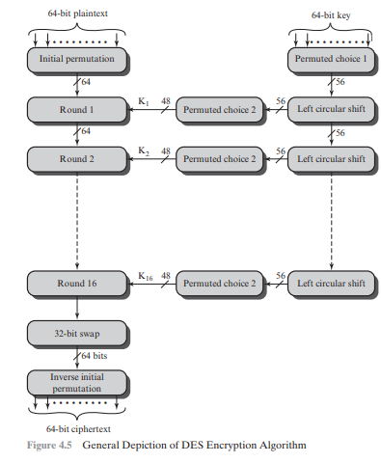

Slide 15
DATA ENCRYPTION STANDARD
The overall scheme for DES encryption is illustrated in Figure 4.5. As with any encryption scheme, there are two inputs to the encryption function: the plaintext to be encrypted and the key.
In this case, the plaintext must be 64 bits in length and the key is 56 bits in length. Looking at the left-hand side of the figure, we can see that the processing of the plaintext proceeds in three phases.
First, the 64-bit plaintext passes through an initial permutation (IP) that rearranges the bits to produce the permuted input.
This is followed by a phase consisting of sixteen rounds of the same function, which involves both permutation and substitution functions.
The output of the last (sixteenth) round consists of 64 bits that are a function of the input plaintext and the key. The left and right halves of the output are swapped to produce the preoutput.
As with any Feistel cipher, decryption uses the same algorithm as encryption, except that the application of the subkeys is reversed. Additionally, the initial and final permutations are reversed

Slide 16
DATA ENCRYPTION STANDARD
Finally, the preoutput is passed through a permutation [IP-1 ] that is the inverse of the initial permutation function, to produce the 64-bit ciphertext. With the exception of the initial and final permutations, DES has the exact structure of a Feistel cipher, as shown in Figure 4.3
The right-hand portion of Figure 4.5 shows the way in which the 56-bit key is used. Initially, the key is passed through a permutation function.
Then, for each of the sixteen rounds, a subkey (Ki ) is produced by the combination of a left circular shift and a permutation. The permutation function is the same for each round, but a different subkey is produced because of the repeated shifts of the key bits.

Slide 17
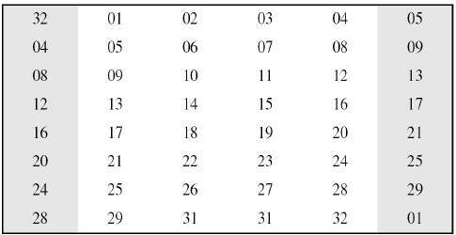
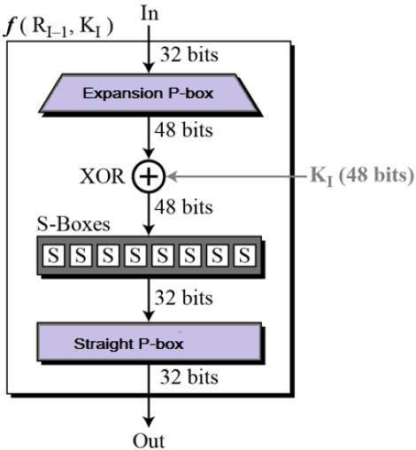
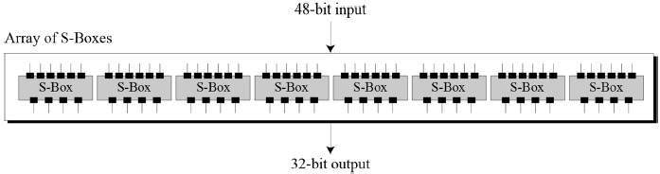
DATA ENCRYPTION STANDARD
Expansion P Box
Mangler Function

Slide 18
DATA ENCRYPTION STANDARD
In Key generation in the first Step eight Parity bits are dropped i.e 8,16,24,32,40,48,56,64 are dropped to generate Effective key of 56 bits.
In Left Circular Shift Li where i refers to Rounds, for
i= 1,2,9,16 it is going to have one shift operation
& for other rounds it is going to have two shift operation.
In Permuted Choice we perform Contraction Permutation and generate 48 bit Key by dropping 8 bits again.

Slide 19
WEAKNESS IN DES
DES has been proven to be susceptible to Crpytanalysis.
56-bit keys have a keyspace of 2^{56.}
As we know the DES uses 56 bit key to encrypt any plain text which can be easily be cracked by using modern technologies.
To prevent this from happening double DES and triple DES were introduced which are much more secure than the original DES because it uses 112 and 168 bit keys respectively.
They offer much more security than DES.

Slide 20
DOUBLE DES
Double DES is a encryption technique which uses two instance of DES on same plain text.
In both instances it uses different keys to encrypt the plain text. Both keys are required at the time of decryption.
The 64 bit plain text goes into first DES instance which then converted into a 64 bit middle text using the first key and then it goes to second DES instance which gives 64 bit cipher text by using second key.
Meet-in-the middle attack which can be used to break through double DES.

Slide 21
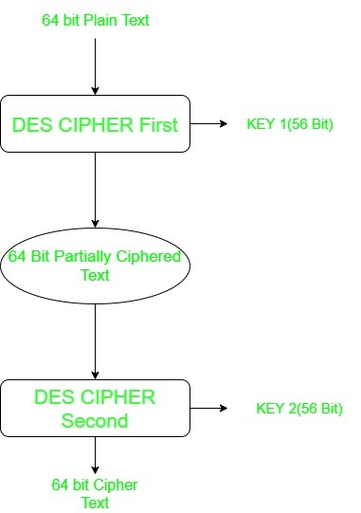
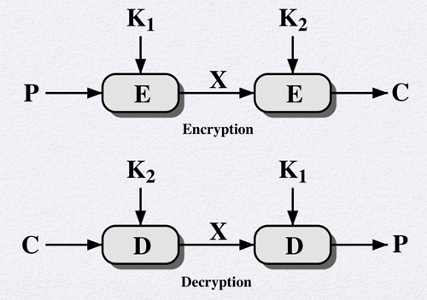

Slide 22
TRIPLE DES
Triple DES is a encryption technique which uses three instance of DES on same plain text. It uses there different types of key choosing technique in first all used keys are different and in second two keys are same and one is different and in third all keys are same.
Before using 3TDES, user first generate and distribute a 3TDES key K, which consists of three different DES keys K1, K2 and K3.
This means that the actual 3TDES key has length 3×56 = 168 bits.
Triple DES systems are significantly more secure than single DES, but these are clearly a much slower process than encryption using single DES.

Slide 23
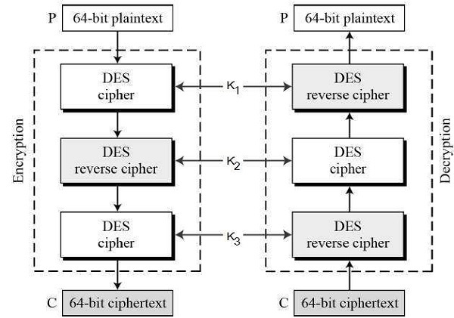

Slide 24
BLOCK CIPHER MODES OF OPERATION
Encryption algorithms are divided into two categories based on the input type, as a block cipher and stream cipher.
Block cipher is an encryption algorithm that takes a fixed size of input say b bits and produces a ciphertext of b bits again.
If the input is larger than b bits it can be divided further.
For different applications and uses, there are several modes of operations for a block cipher.

Slide 25
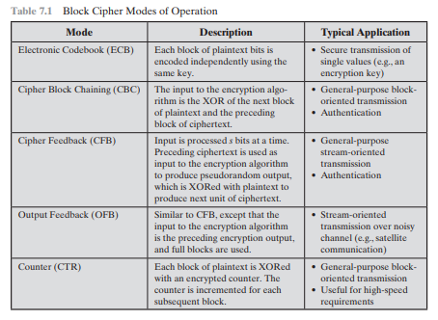

Slide 26
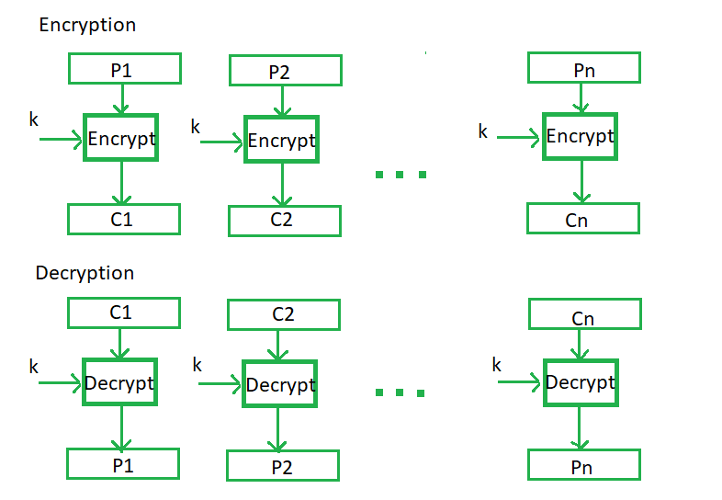
Electronic Codebook Mode
Electronic code book is the easiest block cipher mode of functioning.
It is easier because of direct encryption of each block of input plaintext and output is in form of blocks of encrypted ciphertext.
Generally, if a message is larger than b bits in size, it can be broken down into a bunch of blocks and the procedure is repeated
Advantages of using ECB –
Parallel encryption of blocks of bits is possible, thus it is a faster way of encryption.
Simple way of the block cipher.
Disadvantages of using ECB –
Prone to cryptanalysis since there is a direct relationship
between plaintext and ciphertext.

Slide 27
Cipher Blockchaining Mode
Cipher block chaining or CBC is an advancement made on ECB since ECB compromises some security requirements.
In CBC, the previous cipher block is given as input to the next encryption algorithm after XOR with the original plaintext block.
In a nutshell here, a cipher block is produced by encrypting an XOR output of the previous cipher block and present plaintext block
Advantages of CBC –
CBC works well for input greater than b bits.
CBC is a good authentication mechanism.
Better resistive nature towards cryptanalysis than ECB.
Disadvantages of CBC –
Parallel encryption is not possible since every encryption requires a previous cipher.
.

Slide 28
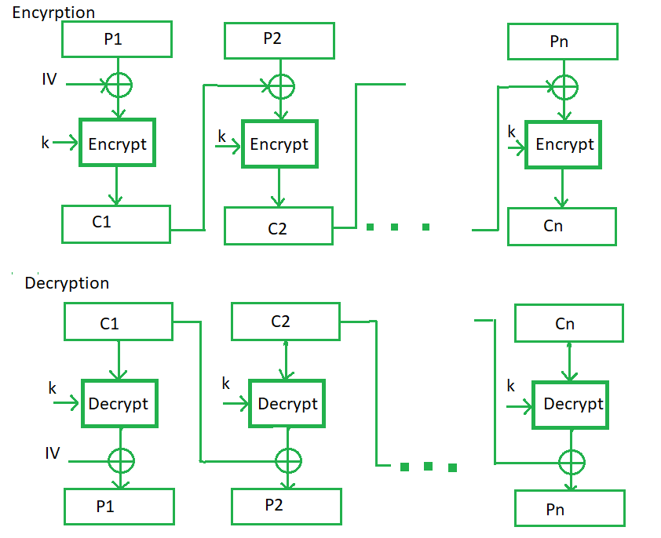

Slide 29
Cipher Feedback Mode
In this mode the cipher is given as feedback to the next block of encryption with some new specifications: first, an initial vector IV is used for first encryption and output bits are divided as a set of s and b-s bits.
The left-hand side s bits are selected along with plaintext bits to which an XOR operation is applied.
The result is given as input to a shift register having b-s bits to lhs,s bits to rhs and the process continues.
The encryption and decryption process for the same is shown below, both of them use encryption algorithms.
Advantages of CFB –
Since, there is some data loss due to the use of shift register, thus it is difficult for applying cryptanalysis.
Disadvantages of using CFB –
The drawbacks of CFB are the same as those of CBC mode. Both block losses and concurrent encryption of several blocks are not supported by the encryption. Decryption, however, is parallelizable and loss-tolerant.

Slide 30
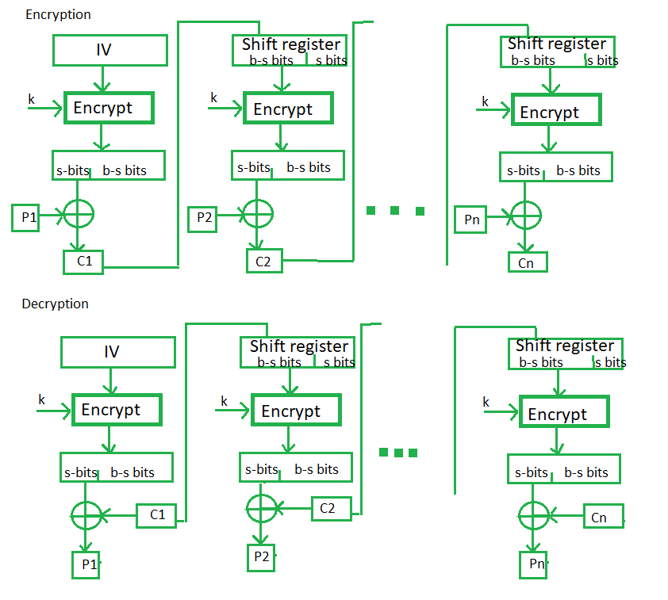

Slide 31
Output Feedback Mode
The output feedback mode follows nearly the same process as the Cipher Feedback mode except that it sends the encrypted output as feedback instead of the actual cipher which is XOR output.
In this output feedback mode, all bits of the block are sent instead of sending selected s bits.
The Output Feedback mode of block cipher holds great resistance towards bit transmission errors. It also decreases the dependency or relationship of the cipher on the plaintext.
Advantages of OFB –
In the case of CFB, a single bit error in a block is propagated to all subsequent blocks. This problem is solved by OFB as it is free from bit errors in the plaintext block.
Disadvantages of OFB-
The drawback of OFB is that, because to its operational modes, it is more susceptible to a message stream modification attack than CFB.

Slide 32
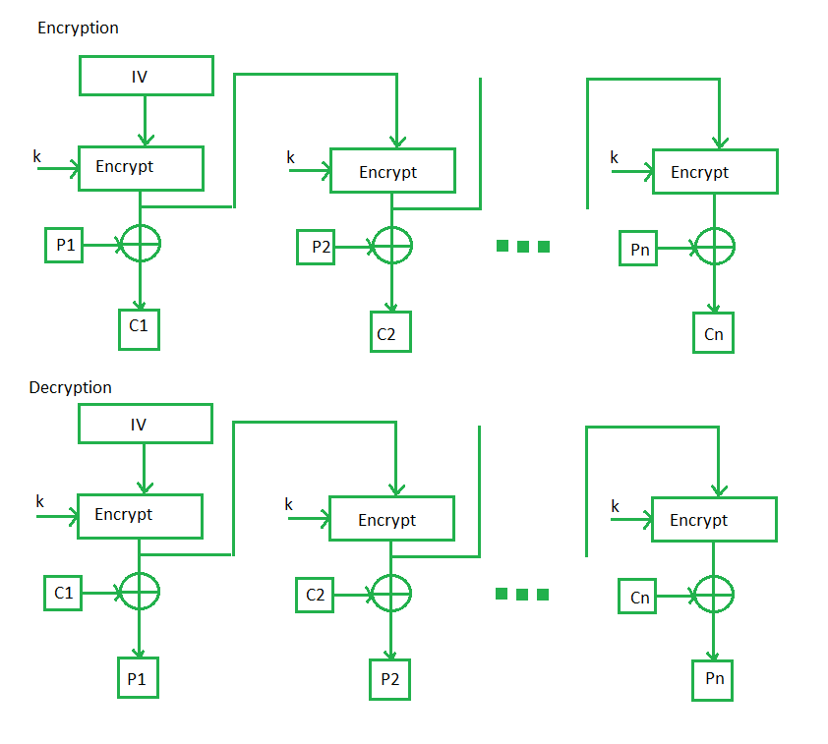

Slide 33
Counter Feedback Mode
The Counter Mode or CTR is a simple counter-based block cipher implementation.
Every time a counter-initiated value is encrypted and given as input to XOR with plaintext which results in ciphertext block.
The CTR mode is independent of feedback use and thus can be implemented in parallel.
Advantages of Counter –
Since there is a different counter value for each block, the direct plaintext and ciphertext relationship is avoided. This means that the same plain text can map to different ciphertext.
Parallel execution of encryption is possible as outputs from previous stages are not chained as in the case of CBC.
Disadvantages of Counter-
The fact that CTR mode requires a synchronous counter at both the transmitter and the receiver is a severe drawback. The recovery of plaintext is erroneous when synchronisation is lost.

Slide 34
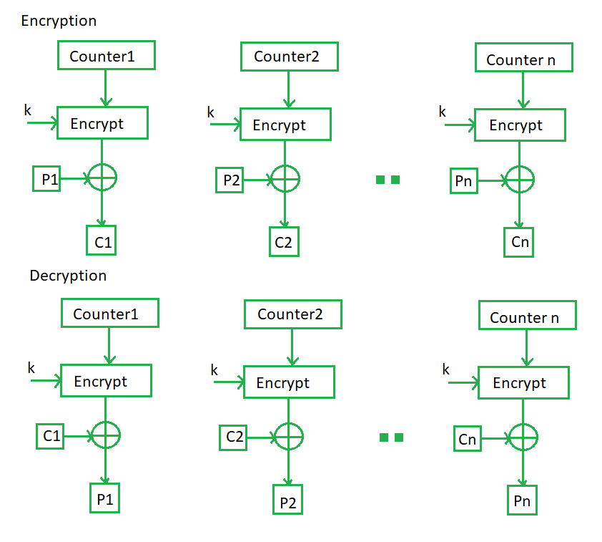

Slide 35
ADVANCED ENCRYPTION STANDARD
The Advanced Encryption Standard (AES) was published by the National Institute of Standards and Technology (NIST) in 2001.
AES is a symmetric block cipher that is intended to replace DES.
It can work with three key sizes-128,192,256 bits,
AES is considered highly secure due to its long key sizes and is still used in industries.
Based on the key length i.e 16, 24, or 32 bytes (128, 192, or 256 bits),the algorithm is referred to as AES-128, AES-192, or AES-256.

Slide 36
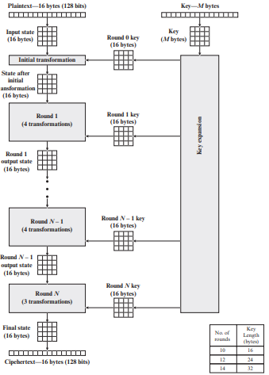
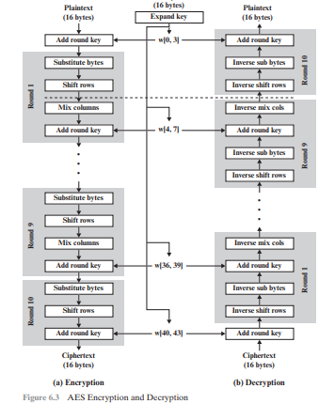

Slide 37
ADVANCED ENCRYPTION STANDARD
Figure 6.1 shows the overall structure of the AES encryption process. The cipher takes a plaintext block size of 128 bits, or 16 bytes.
The input to the encryption and decryption algorithms is a single 128-bit block.
This block is depicted as a 4 * 4 square matrix of bytes. This block is copied into the State array, which is modified at each stage of encryption or decryption.
After the final stage, State is copied to an output matrix. These operations are depicted in Figure 6.2a.
Similarly, the key is depicted as a square matrix of bytes. This key is then expanded into an array of key schedule words. Figure 6.2b shows the expansion for the 128-bit key. Each word is four bytes, and the total key schedule is 44 words for the 128-bit key.

Slide 38
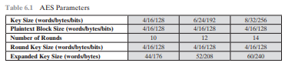
ADVANCED ENCRYPTION STANDARD
The cipher consists of N rounds, where the number of rounds depends on the key length: 10 rounds for a 16-byte key, 12 rounds for a 24-byte key, and 14 rounds for a 32-byte key.
The first N - 1 rounds consist of four distinct transformation functions: SubBytes, ShiftRows, MixColumns, and AddRoundKey, which are described subsequently.
The final round contains only three transformations, and there is a initial single transformation (AddRoundKey) before the first round, which can be considered Round 0.

Slide 39
ADVANCED ENCRYPTION STANDARD
Four different stages are used, one of permutation and three of substitution:
Substitute bytes: Uses an S-box to perform a byte-by-byte substitution of the block.
ShiftRows: A simple permutation.
MixColumns: A substitution that makes use of arithmetic over GF(28 ).
AddRoundKey: A simple bitwise XOR of the current block with a portion of the expanded key.

Slide 40
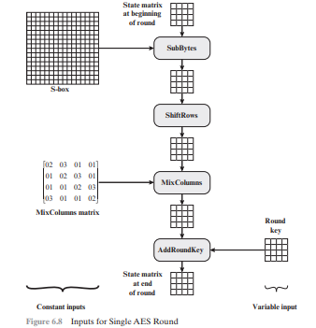

Slide 41
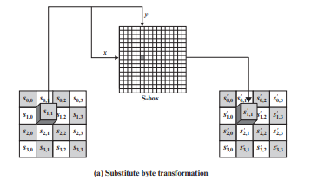
SUBSTITUTE BYTES TRANSFORMATION
AES defines a 16 * 16 matrix of byte values, called an S-box (Table 6.2a), that contains a permutation of all possible 256 8-bit values.
Each individual byte of State is mapped into a new byte in the following way: The leftmost 4 bits of the byte are used as a row value and the rightmost 4 bits are used as a column value.
These row and column values serve as indexes into the S-box to select a unique 8-bit output value.
For example, the hexadecimal value {95} references row 9, column 5 of the S-box, which contains the value {2A}. Accordingly, the value {95} is mapped into the value {2A}.

Slide 42
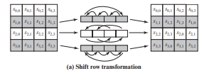
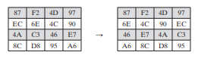
SHIFT ROWS TRANSFORMATION
The first row of State is not altered. For the second row, a 1-byte circular left shift is performed. For the third row, a 2-byte circular left shift is performed. For the fourth row, a 3-byte circular left shift is performed. The following is an example of ShiftRows

Slide 43
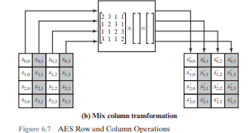
MIX COLUMN TRANSFORMATION
Each byte of a column is mapped into a new value that is a function of all four bytes in that column. The transformation can be defined by the following matrix multiplication on State
In AddRoundKey, the 128 bits of State are bitwise XORed with the 128 bits of the round key.

Slide 44
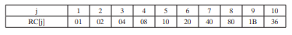
AES KEY EXPANSION
The AES key expansion algorithm takes as input a four-word (16-byte) key and produces a linear array of 44 words (176 bytes). This is sufficient to provide a fourword round key for the initial AddRoundKey stage and each of the 10 rounds of the cipher.
RotWord performs a one-byte circular left shift on a word. This means that an input word [B0, B1, B2, B3] is transformed into [B1, B2, B3, B0].
SubWord performs a byte substitution on each byte of its input word, using the S-box (Table 6.2a).
The result of steps 1 and 2 is XORed with a round constant, Rcon[j].
The round constant is a word in which the three rightmost bytes are always 0. [Rcon[j] = (RC[j], 0, 0, 0)]

Slide 45
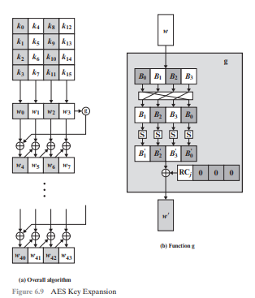
AES KEY EXPANSION

Slide 46
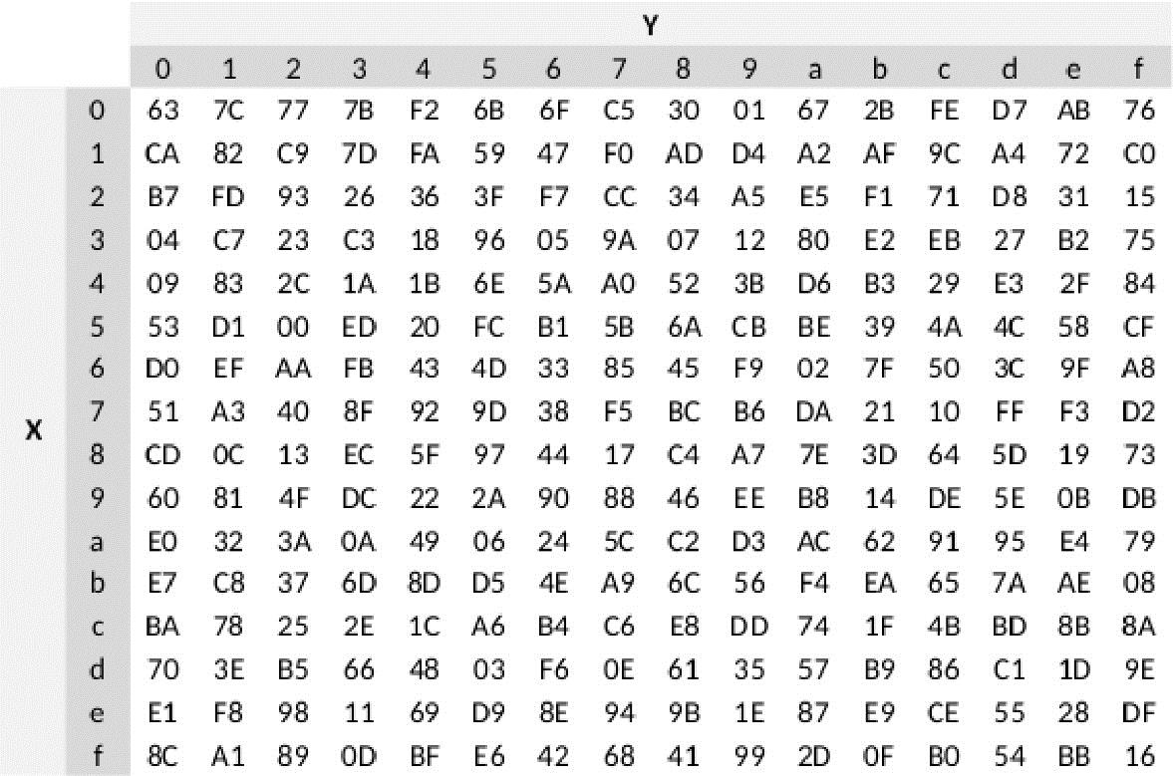
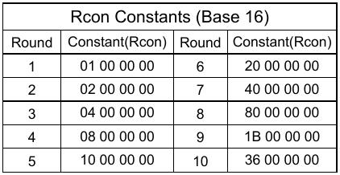
Round Constants in AES
S-Box in AES

Slide 47
RC5 (RIVEST CIPHER 5)
RC5 is a Block Cipher with a variety of parameters: block size, key size, and number of rounds.
It was invented by Ron Rivest and analyzed by RSA Laboratories.
There are three operations: XOR, addition, and rotations.
RC5 has a variable-length block.
Once w, r, k (word size, number of rounds, number of keys) are finalized then they remain same for all the rounds.
Plain text block/word size (bits) can be16, 32, 64
Number of rounds can be between 0-255
Key size can be between 0 to 255 bytes.
The main feature of RC5 is that it is quite fast as it only uses primitive computer operations (addition, XOR,shift).
Another important feature of RC5 is that it requires less memory for execution and is therefore suitable for desktop computers, smart cards and other devices that have small memory capacity.

Slide 48
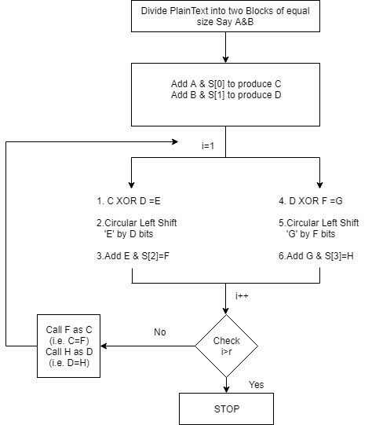

Slide 49
We initialize the counter to 1 and perform some permutation and combination using addition and XOR
The algorithm works into two phases:
a. First it starts with phase one
b. Output of phase one become input of phase two
We divide the plaintext block into two equal parts A and B
Then they are XOR with two subkeys S{0} and S{1}
C=A+S[0] AND D=B+S[1]
for i = 1 to r do:
1. C ⊕ D = E
2. perform circular left shift on E by D bits
3. add E and S[2 * i] and store the result in F which is input for step 4
4. D ⊕ F = G
5. perform circular left shift on G by F bits
6. add G and S[2 * i + 1] and store the result in H
7. If i< r
Call F as C and H as D and repeat the steps from 1 to 7
else stop
Once both the phases are completed the counter is incriminated and we check if it is greater than the number of rounds, if yes then the algorithm terminals and if no then the algorithm iterates.
Decryption:Decryption is a straightforward reversal of the encryption process

Slide 50
PUBLIC KEY CRYPTOGRAPHY
Asymmetric algorithms rely on one key for encryption and a different but related key for decryption. These algorithms have the following important characteristic.
■ It is computationally infeasible to determine the decryption key given only knowledge of the cryptographic algorithm and the encryption key. In addition, some algorithms, such as RSA, also exhibit the following characteristic.
■ Either of the two related keys can be used for encryption, with the other used for decryption.

Slide 51
PUBLIC KEY CRYPTOGRAPHY
A public-key encryption scheme has six ingredients (Figure 9.1a; compare with Figure 3.1).
■ Plaintext: This is the readable message or data that is fed into the algorithm as input.
■ Encryption algorithm: The encryption algorithm performs various transformations on the plaintext.
■ Public and private keys: This is a pair of keys that have been selected so that if one is used for encryption, the other is used for decryption. The exact transformations performed by the algorithm depend on the public or private key that is provided as input.
■ Ciphertext: This is the encrypted message produced as output. It depends on the plaintext and the key. For a given message, two different keys will produce two different ciphertexts.
■ Decryption algorithm: This algorithm accepts the ciphertext and the matching key and produces the original plaintext.

Slide 52
PUBLIC KEY CRYPTOGRAPHY
The essential steps are the following.
1. Each user generates a pair of keys to be used for the encryption and decryption of messages.
2. Each user places one of the two keys in a public register or other accessible file. This is the public key. The companion key is kept private. As Figure 9.1a suggests, each user maintains a collection of public keys obtained from others.
3. If Bob wishes to send a confidential message to Alice, Bob encrypts the message using Alice’s public key.
4. When Alice receives the message, she decrypts it using her private key. No other recipient can decrypt the message because only Alice knows Alice’s private key.
With this approach, all participants have access to public keys, and private keys are generated locally by each participant and therefore need never be distributed. As long as a user’s private key remains protected and secret, incoming communication is secure
To discriminate between the two, we refer to the key used in symmetric encryption as a secret key. The two keys used for asymmetric encryption are referred to as the public key and the private key. 2 Invariably, the private key is kept secret, but it is referred to as a private key rather than a secret key to avoid confusion with symmetric encryption

Slide 53
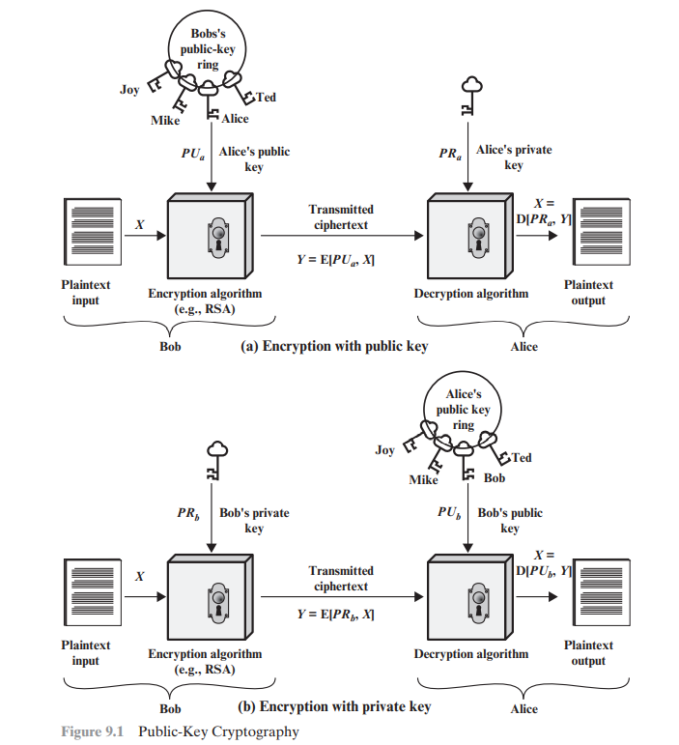

Slide 54
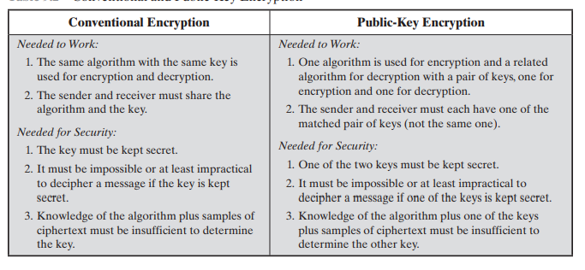
CONVENTIONAL and PUBLIC KEY CRYPTOGRAPHY

Slide 55
APPLICATIONS OF PUBLIC KEY CRYPTOGRAPHY
In broad terms, we can classify the use of public-key cryptosystems into three categories
■ Encryption/decryption: The sender encrypts a message with the recipient’s public key, and the recipient decrypts the message with the recipient’s private key.
■ Digital signature: The sender “signs” a message with its private key. Signing is achieved by a cryptographic algorithm applied to the message or to a small block of data that is a function of the message.
■ Key exchange: Two sides cooperate to exchange a session key, which is a secret key for symmetric encryption generated for use for a particular transaction (or session) and valid for a short period of time. Several different approaches are possible, involving the private key(s) of one or both parties;

Slide 56
RSA Algorithm
One of the first successful responses to the challenge was developed in 1977 by Ron Rivest, Adi Shamir, and Len Adleman at MIT and first published in 1978.
The Rivest-Shamir-Adleman (RSA) scheme has since that time reigned supreme as the most widely accepted and implemented general-purpose approach to public-key encryption.
The RSA scheme is a cipher in which the plaintext and ciphertext are integers between 0 and n - 1 for some n. A typical size for n is 1024 bits, or 309 decimal digits. That is, n is less than 21024.
RSA makes use of an expression with exponentials.

Slide 57
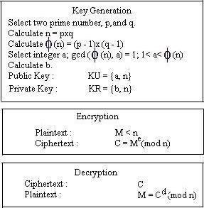
RSA Algorithm
b= a x b = 1 mod Φ(n)

Slide 58
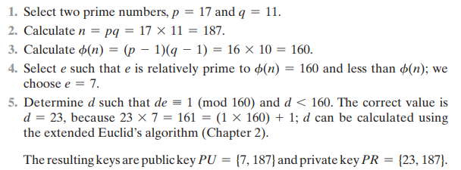
RSA Algorithm

Slide 59
SECURITY OF RSA
Five possible approaches to attacking the RSA algorithm are
■ Brute force: This involves trying all possible private keys.
■ Mathematical attacks: There are several approaches, all equivalent in effort to factoring the product of two primes.
■ Timing attacks: These depend on the running time of the decryption algorithm.
■ Chosen ciphertext attacks: This type of attack exploits properties of the RSA algorithm
■ Hardware fault-based attack: This involves inducing hardware faults in the processor that is generating digital signatures.

Slide 60
SECURITY OF RSA
The defense against the brute-force approach is the same for RSA as for other cryptosystems, namely, to use a large key space. Thus, the larger the number of bits in d, the better. However, because the calculations involved, both in key generation and in encryption/decryption, are complex, the larger the size of the key, the slower the system will run.
THE FACTORING PROBLEM We can identify three approaches to attacking RSA mathematically.
1. Factor n into its two prime factors. This enables calculation of f(n) = (p - 1) * (q - 1), which in turn enables determination of d K e-1 (mod f(n)).
2. Determine f(n) directly, without first determining p and q. Again, this enables determination of d K e-1 (mod f(n)).
3. Determine d directly, without first determining f(n).

Slide 61
SECURITY OF RSA
A timing attack is somewhat analogous to a burglar guessing the combination of a safe by observing how long it takes for someone to turn the dial from number to number.
Countermeasures:
■ Constant exponentiation time: Ensure that all exponentiations take the same amount of time before returning a result. This is a simple fix but does degrade performance.
■ Random delay: Better performance could be achieved by adding a random delay to the exponentiation algorithm to confuse the timing attack. Kocher points out that if defenders don’t add enough noise, attackers could still succeed by collecting additional measurements to compensate for the random delays.
■ Blinding: Multiply the ciphertext by a random number before performing exponentiation. This process prevents the attacker from knowing what ciphertext bits are being processed inside the computer and therefore prevents the bit-by-bit analysis essential to the timing attack.

Slide 62
SECURITY OF RSA
The basic RSA algorithm is vulnerable to a chosen ciphertext attack (CCA). CCA is defined as an attack in which the adversary chooses a number of ciphertexts and is then given the corresponding plaintexts, decrypted with the target’s private key.
Thus, the adversary could select a plaintext, encrypt it with the target’s public key, and then be able to get the plaintext back by having it decrypted with the private key.
A solution can be optimal asymmetric encryption padding (OAEP)

Slide 63
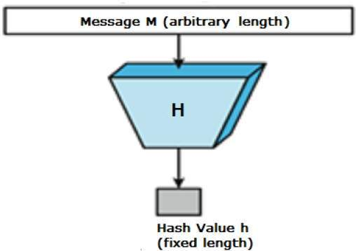
HASHING
Hash functions are extremely useful and appear in almost all information security applications.
A hash function is a mathematical function that converts a numerical input value into another compressed numerical value. The input to the hash function is of arbitrary length but output is always of fixed length.
A cryptographic hash function is an algorithm that takes an arbitrary amount of data input—a credential—and produces a fixed-size output of enciphered text called a hash value, or just “hash.”
Values returned by a hash function are called message digest or simply hash values.
A hash function is a versatile one-way cryptographic algorithm that maps an input of any size to a unique output of a fixed length of bits.
When you hash data, the resulting digest is typically smaller than the input that it started with.
With hashing, it doesn’t matter if you have a one-sentence message or an entire book — the result will still be a fixed-length chunk of bits

Slide 64
Process of Hashing
Create Information
Calculate the Hash Value
Encrypt the message
Send the Encrypted message and the Hash Value
Receive the Encrypted message and the Hash Value
Decrypt the message
Calculate its hash value at the receiving end
Compare the hashes
If matched, Process the information, else reject.

Slide 65
Properties of Hashing
The typical features of hash functions are −
Fixed Length Output Hash Value: Hash function converts data of arbitrary length to a fixed length. This process is often referred to as hashing the data. In general, the hash is much smaller than the input data, hence hash functions are sometimes called compression functions. Since a hash is a smaller representation of a larger data, it is also referred to as a digest. Hash function with n bit output is referred to as an n-bit hash function. Popular hash functions generate values between 160 and 512 bits.
Efficiency of Operation: Generally for any hash function h with input x, computation of hx is a fast operation. Computationally hash functions are much faster than a symmetric encryption.
Pseudorandomness

Slide 66
Properties of Hashing
Pre-Image Resistance(One way Function): This property means that it should be computationally hard to reverse a hash function. In other words, if a hash function h produced a hash value z, then it should be a difficult process to find any input value x that hashes to z. This property protects against an attacker who only has a hash value and is trying to find the input.
Second Pre-Image Resistance: This property means given an input and its hash, it should be hard to find a different input with the same hash. In other words, if a hash function h for an input x produces hash value hx, then it should be difficult to find any other input value y such that hy = hx. This property of hash function protects against an attacker who has an input value and its hash, and wants to substitute different value as legitimate value in place of original input value.
Collision Resistance This property means it should be hard to find two different inputs of any length that result in the same hash. This property is also referred to as collision free hash function. In other words, for a hash function h, it is hard to find any two different inputs x and y such that hx = hy. Since, hash function is compressing function with fixed hash length, it is impossible for a hash function not to have collisions. This property of collision free only confirms that these collisions should be hard to find. This property makes it very difficult for an attacker to find two input values with the same hash.

Slide 67
SHA
SHA was developed by the National Institute of Standards and Technology (NIST) and published as a federal information processing standard (FIPS 180) in 1993.
When weaknesses were discovered in SHA, now known as SHA-0, a revised version was issued as FIPS 180-1 in 1995 and is referred to as SHA-1.
The actual standards document is entitled “Secure Hash Standard.” SHA is based on the hash function MD4, and its design closely models MD4.
SHA-1 produces a hash value of 160 bits. In 2002, NIST produced a revised version of the standard, FIPS 180-2, that defined three new versions of SHA, with hash value lengths of 256, 384, and 512 bits, known as SHA-256, SHA-384, and SHA-512, respectively. Collectively, these hash algorithms are known as SHA-2.

Slide 68
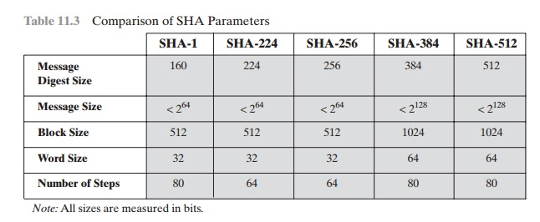
SHA

Slide 69
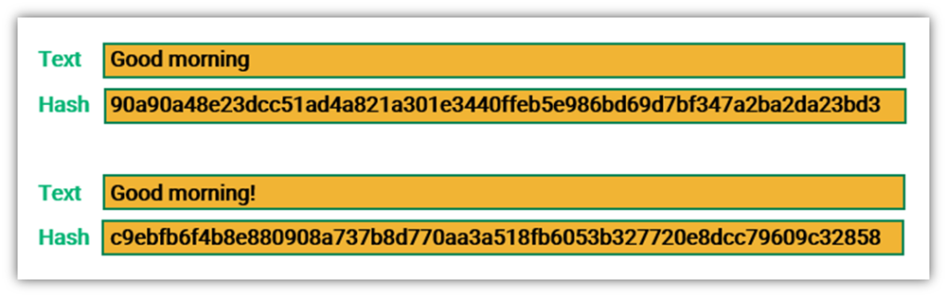
SHA 256
SHA-256, which stands for secure hash algorithm 256, is a cryptographic hashing algorithm (or function) that’s used for message, file, and data integrity verification.
Published in 2001, it was a joint effort between the NSA and NIST to introduce a successor to the SHA 1 family, which was slowly losing strength against brute force attacks.
It’s part of the SHA-2 family of hash functions and uses a 256-bit key to take a piece of data and convert it into a new, unrecognizable data string of a fixed length.
This string of random characters and numbers, called a hash value, is also 256 bits in size.

Slide 70
SHA 256
Some of the standout features of the SHA algorithm are as follows:
Message Length: The length of the cleartext should be less than 264 bits. The size needs to be in the comparison area to keep the digest as random as possible.
Digest Length: The length of the hash digest should be 256 bits in SHA 256 algorithm, 512 bits in SHA-512, and so on. Bigger digests usually suggest significantly more calculations at the cost of speed and space.
Irreversible: By design, all hash functions such as the SHA 256 are irreversible. You should neither get a plaintext when you have the digest beforehand nor should the digest provide its original value when you pass it through the hash function again.

Slide 71
SHA 256
SHA 256 follows the steps given below:
First, data is converted into binary. Binary code uses 0s and 1s to store information. For example, the letter ‘a’ is written as ‘01000001’ in this basic computer language.
The binary data is divided into blocks of 512 bits. If the block is smaller than 512, it’ll be expanded to that size by adding bits of “padding.” If it’s larger, it’ll be broken into blocks of 512 bits. (If the last block isn’t exactly 512 bits, padding is added to the last block to make it 512 bits.)
The message is further divided into smaller blocks that are 32 bits each.
Sixty-four iterations (rounds) of compression functions are performed, wherein the hash values generated above are rotated in a specific pattern and additional data gets added.
New hash values are created from the output of the previous operations.
In the last round, one final 256-bit hash value is produced — this hash digest is the end product of SHA 256.

Slide 72
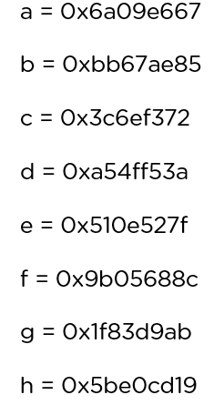
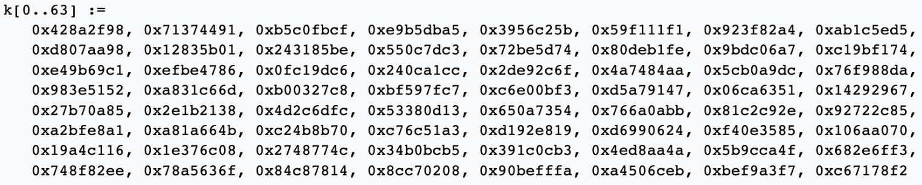
SHA 256
Padding Bits: It adds some extra bits to the message, such that the length is exactly 64 bits short of a multiple of 512. During the addition, the first bit should be one, and the rest of it should be filled with zeroes.
Padding Length: You can add 64 bits of data now to make the final plaintext a multiple of 512. You can calculate these 64 bits of characters by applying the modulus to your original cleartext without the padding.
Initialising the Buffers: You need to initialize the default values for eight buffers to be used in the rounds as follows:
You also need to store 64 different keys in an array, ranging from K[0] to K[63]. They are initialized as follows:

Slide 73
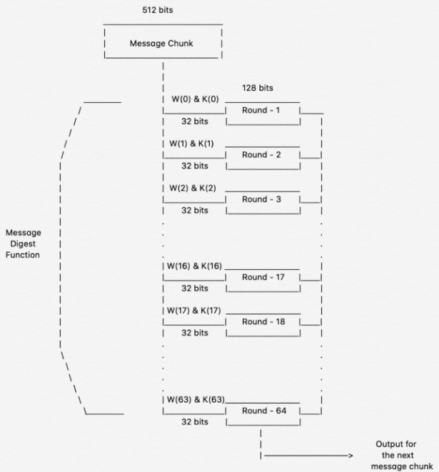
SHA 256
Compression Functions: The entire message gets broken down into multiple blocks of 512 bits each. It puts each block through 64 rounds of operation, with the output of each block serving as the input for the following block. The entire process is as follows:

Slide 74
SHA 512
SHA-512, or Secure Hash Algorithm 512, is a hashing algorithm used to convert text of any length into a fixed-size string. Each output produces a SHA-512 length of 512 bits (64 bytes).
This algorithm is commonly used for email addresses hashing, password hashing, and digital record verification. SHA-512 is also used in blockchain technology.
The algorithm takes as input a message with a maximum length of less than 128 bits and produces as output a 512-bit message digest. The input is processed in 1024-bit blocks. Figure 11.9 depicts the overall processing of a message to produce a digest.
Step 1: Append padding bits: The message is padded so that its length is congruent to 896 modulo 1024 [length K 896(mod 1024)]. Padding is always added, even if the message is already of the desired length. Thus, the number of padding bits is in the range of 1 to 1024. The padding consists of a single 1 bit followed by the necessary number of 0 bits.
STEP 2: Append length. A block of 128 bits is appended to the message. This block is treated as an unsigned 128-bit integer (most significant byte first) and contains the length of the original message (before the padding).
The outcome of the first two steps yields a message that is an integer multiple of 1024 bits in length. In Figure 11.9, the expanded message is represented as the sequence of 1024-bit blocks M1, M2, c, MN, so that the total length of the expanded message is N * 1024bits.

Slide 75
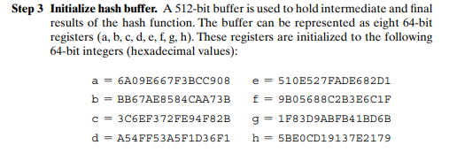
Step 4:Process message in 1024-bit (128-word) blocks: The heart of the algorithm is a module that consists of 80 rounds; this module is labeled F in Figure.
Each round takes as input the 512-bit buffer value, abcdefgh, and updates the contents of the buffer. At input to the first round, the buffer has the value of the intermediate hash value, Hi-1.
Each round t makes use of a 64-bit value Wt, derived from the current 1024-bit block being processed (Mi ). These values are derived using a message schedule described subsequently. Each round also makes use of an additive constant Kt, where 0 … t … 79 indicates one of the 80 rounds.
Step 5 Output. After all N 1024-bit blocks have been processed, the output from the Nth stage is the 512-bit message digest.

Slide 76
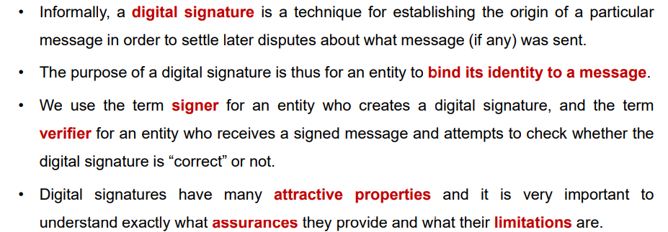
Digital Signatures

Slide 77
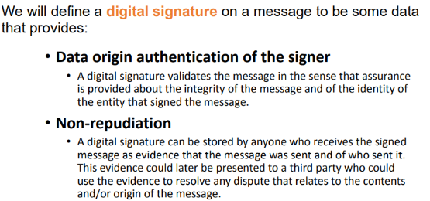
Digital Signature Security Requirement

Slide 78
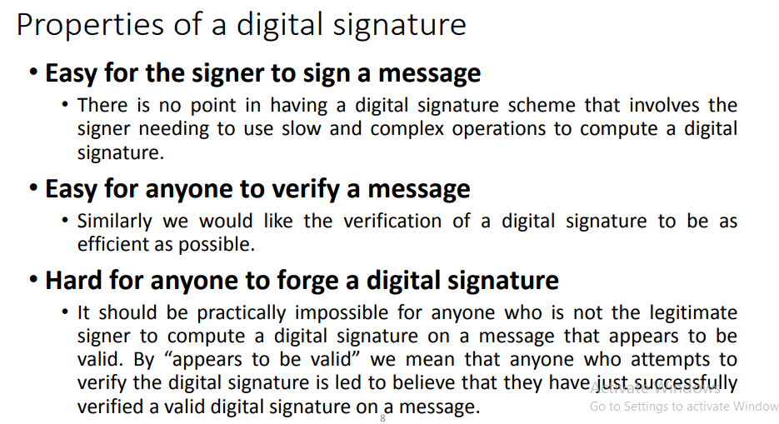

Slide 79
How it Works?
A Digital Signature Scheme will have two components, a private signing algorithm which permits a user to securely sign a message and a public verification algorithm which permits anyone to verify that the signature is authentic.
The signing algorithm needs to "bind" a signature to a message in such a way that the signature cannot be pulled out and used to sign another document, or have the original message modified and the signature remain valid.
For practical reasons it would be necessary for both algorithms to be relatively fast and if small computers such as smart cards are to be used, the algorithms can not be too computationally complex.

Slide 80
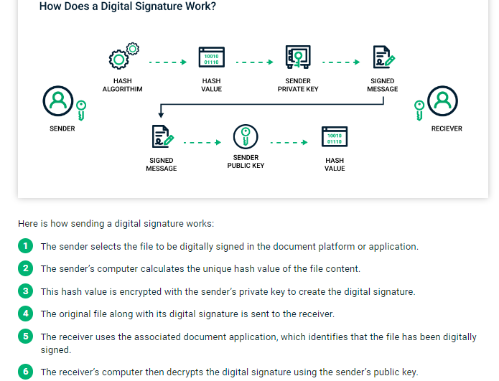

Slide 81
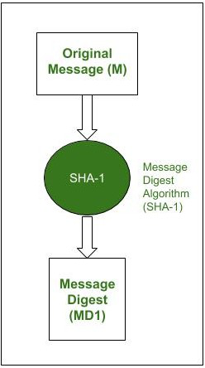
RSA Digital Signature Scheme
It is the most popular asymmetric cryptographic algorithm. It is primarily used for encrypting messages but can also be used for performing digital signature over a message. Let us understand how RSA can be used for performing digital signatures step-by-step. Assume that there is a sender (A) and a receiver (B). A wants to send a message (M) to B along with the digital signature (DS) calculated over the message.
Step-1 : Sender A uses SHA-1 Message Digest Algorithm to calculate the message digest (MD1) over the original message M.

Slide 82
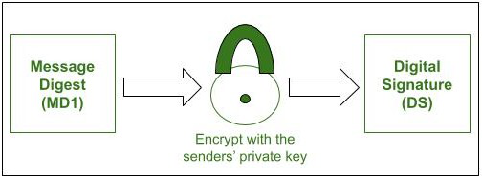
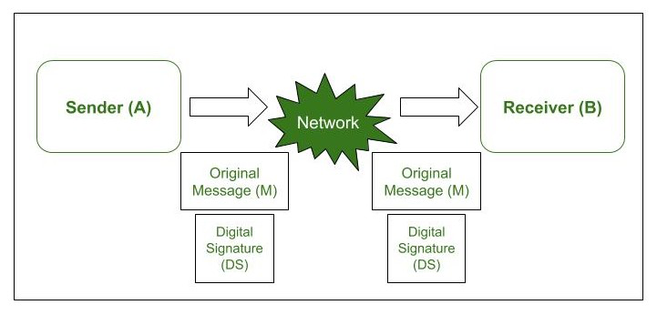
RSA Digital Signature Scheme
Step-2 : A now encrypts the message digest with its private key. The output of this process is called Digital Signature (DS) of A.
Step-3 : Now sender A sends the digital signature (DS) along with the original message (M) to B.

Slide 83
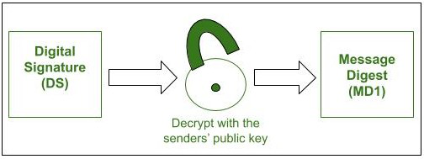
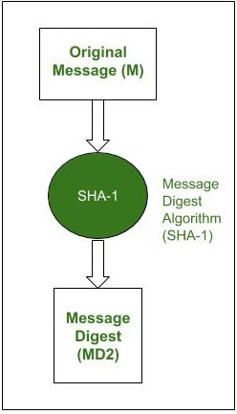

RSA Digital Signature Scheme
Step-4 : When B receives the Original Message(M) and the Digital Signature(DS) from A, it first uses the same message-digest algorithm as was used by A and calculates its own Message Digest (MD2) for M.
Step-5 : Now B uses A’s public key to decrypt the digital signature because it was encrypted by A’s private key. The result of this process is the original Message Digest (MD1) which was calculated by A.
Step-6 : If MD1==MD2, the following facts are established as follows.
B accepts the original message M as the correct, unaltered message from A.
It also ensures that the message came from A and not someone posing as A.

Slide 84
Digital Signature Scheme
Digital Signature is a way to validate the authenticity and integrity of the message or digital or electronic documents.
Authenticity means to check whether the data is coming from a valid source or not to the receiver i.e. to verify the identity of the sender and integrity means to check that the data or message should not be altered during the transmission.
DSS or Digital Signature Standard was introduced by the National Institute of Standards and Technology (NIST) in 1994. It has become the United States government standard for electronic document authentication.
DSS employs SHA (Secure Hash Algorithm) to create digital signatures and offers a new digital signature mechanism known as the Digital Signature Algorithm.
The DSS is different in the fact that the RSA algorithm uses the public key, private key and hash function whereas the DSS uses the public key, private key, hash function, a random number k, and global public key. Therefore, DSS provides more security than RSA algorithms.

Slide 85
Digital Signature Scheme
A hash code is generated from the message and given as input to the signature function on the sender side. The other inputs to a signature function include a unique random number k for the signature, the private key of sender PR(a), and the global public key i.e., PU(g).
The output of the signature function consists of two components: s & r, which are concatenated with the input message and then sent to the receiver. Signature = {s, r}.
On the receiver side, the hash code for the message sent is generated by the receiver by applying a hash function. The verification function is used for verifying the message and signature sent by the sender. The verification function takes the hash code generated, signature components s and r, the public key of the sender (PU(a)), and the global public key.
The signature function is compared with the output of the verification function and if both the values match, the signature is valid because A valid signature can only be generated by the sender using its private key.

Slide 86

Digital Signature Scheme

Slide 87
KERBEROS
Kerberos is a protocol for authenticating service requests between trusted hosts across an untrusted network, such as the internet. Kerberos support is built in to all major computer operating systems, including Microsoft Windows, Apple macOS, FreeBSD and Linux.
Since Windows 2000, Microsoft has used the Kerberos protocol as the default authentication method in Windows, and it is an integral part of the Windows Active Directory (AD) service. Broadband service providers also use the protocol to authenticate cable modems and set-top boxes accessing their networks.
Kerberos was developed for Project Athena at the Massachusetts Institute of Technology (MIT). The name was taken from Greek mythology; Kerberos (Cerberus) was a three-headed dog who guarded the gates of Hades. The three heads of the Kerberos protocol represent the following:\
the client or principal;
the network resource, which is the application server that provides access to the network resource;
a key distribution center (KDC), which acts as Kerberos' trusted third-party authentication service

Slide 88


Slide 89
When a user requests access to a service through the authentication service, they enter their username and password locally, and send the following information:
Security Identifier (SID)
Name of the requested service (for example, example.cool.hat)
User's IP address
Desired lifetime of the Ticket granting ticket (TGT). The default is 10 hours and can be changed via Group Policy. Authentication service issues a ticket granting ticket (TGT) if the user exists in the database. The first message sent back to the user contains:
Security identifier (SID)
TGS ID
Timestamp
User's IP address
TGT lifetime
TGT
Session key

Slide 90

After this message, another message will be sent containing:
TGS ID
Timestamp
Session key
The user sends the TGT to the TGS along with the Kerberos ID of the requested services. Another message is sent containing the "Authenticator", which is composed of the User ID and timestamp, encrypted with the user's session key.

Slide 91


Slide 92
PKI
Public key infrastructure (PKI) is a catch-all term for everything used to establish and manage public key encryption, one of the most common forms of internet encryption.
It is baked into every web browser in use today to secure traffic across the public internet, but organizations can also deploy it to secure their internal communications and access to connected devices.
Public Key Infrastructure (PKI) is a technology for authenticating users and devices in the digital world. The basic idea is to have one or more trusted parties digitally sign documents certifying that a particular cryptographic key belongs to a particular user or device. The key can then be used as an identity for the user in digital networks.
A public key infrastructure relies on digital signature technology, which uses public key cryptography. The basic idea is that the secret key of each entity is only known by that entity and is used for signing. This key is called the private key. There is another key derived from it, called the public key, which is used for verifying signatures but cannot be used to sign. This public key is made available to anyone, and is typically included in the certificate document.

Slide 93

HOW IT WORKS
PKI certificates are documents that act as digital passports, assigned to any entity that wants to participate in a PKI-secured conversation.
They can include quite a bit of data. One of the most important pieces of information a certificate includes is the entity's public key: the certificate is the mechanism by which that key is shared. But there's also the authentication piece.
A certificate includes an attestation from a trusted source that the entity is who they claim to be. That trusted source is generally known as a certificate authority (CA).

Slide 94
X.509
X.509 is a digital certificate that is built on top of a widely trusted standard known as ITU or International Telecommunication Union X.509 standard, in which the format of PKI certificates is defined.
X.509 digital certificate is a certificate-based authentication security framework that can be used for providing secure transaction processing and private information. These are primarily used for handling the security and identity in computer networking and internet-based communications.
The core of the X.509 authentication service is the public key certificate connected to each user. These user certificates are assumed to be produced by some trusted certification authority and positioned in the directory by the user or the certified authority.
Once an X.509 certificate is provided to a user by the certified authority, that certificate is attached to it like an identity card. The chances of someone stealing it or losing it are less, unlike other unsecured passwords. With the help of this analogy, it is easier to imagine how this authentication works: the certificate is basically presented like an identity at the resource that requires authentication.

Slide 95


Slide 96


